Slide 1


Rumah Coding Course "Android Basic"
Studi Kasus Aplikasi "SekolahKu"
Day 4

Slide 2
Course Syllabus
Day 4
Search Data
Change Icon
Add Login Page
Edit Data
Delete Data
Context Menu
Generate Signed APK
SearchView

Slide 3
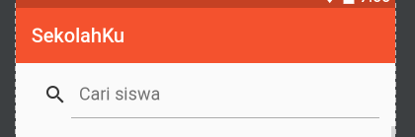
Search View
A widget that provides a user interface for the user to enter a search query and submit a request to a search provider. Shows a list of query suggestions or results, if available, and allows the user to pick a suggestion or result to launch into.

Slide 4
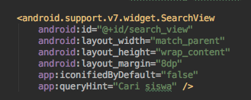
Task #1 Modify activity_list.xml: Add Search View (support v7)

Slide 5
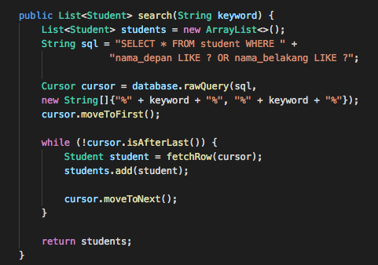
Task #2 Modify StudentDataStore: Add new function: search(keyword) This function should return all student whose nama_depan or nama_belakang contain keyword string.

Slide 6
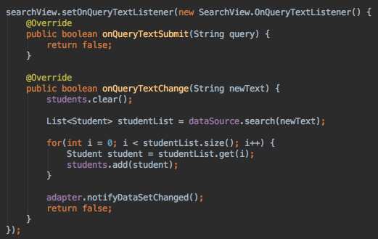
Task #3 Modify ListActivity: Search Student when user typing on SearchView

Slide 7
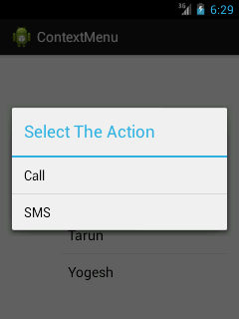
Context Menu
A context menu is a floating menu that appears when the user performs a long-click on an element. It provides actions that affect the selected content or context frame.

Slide 8
Task #4 Show Context Menu: Edit and Delete When a List Item Clicked

Slide 9
Step to Create Context Menu
Create new menu xml file: menu_context.xml
Override method onCreateContextMenu() and inflate R.menu.menu_context.
Override method onContextItemSelected().

Slide 10

Task #5 Modify StudentDataStore: Add new method removeStudent(student)

Slide 11
Task #6 Modify ListActivity: Delete student from database when user click delete context menu. Don't forget to delete it from ListView too.

Slide 12
Refreshing List View
To refresh a ListView after delete an item you must refresh using adapter.
You must refresh the ListView after deleting one or more item.
To refresh an adapter, you can use method: notifyDatasetChanged()

Slide 13
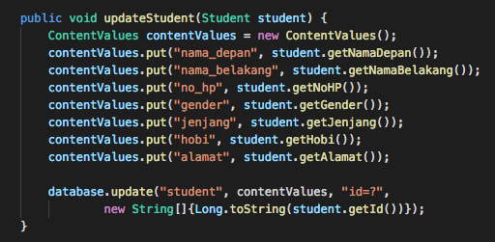
Task #8 Modify StudentDataStore: Add new method updateStudent(student)

Slide 14

Task #9 Modify ListView: Sending student id to FormActivity when user click Edit on Context Menu

Slide 15
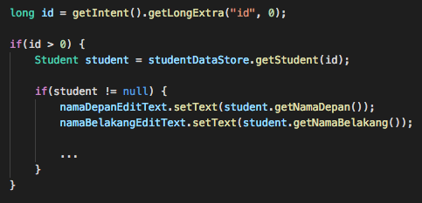
Task #10 Modify FormActivity: If there is student id in intent, load student from database

Slide 16
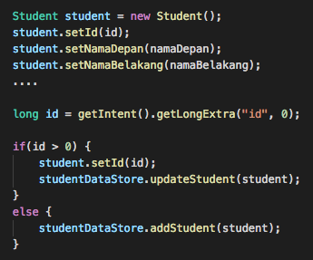
Task #11 Modify save method on FormActivity: if there is student id in intent, update student instead of add student

Slide 17
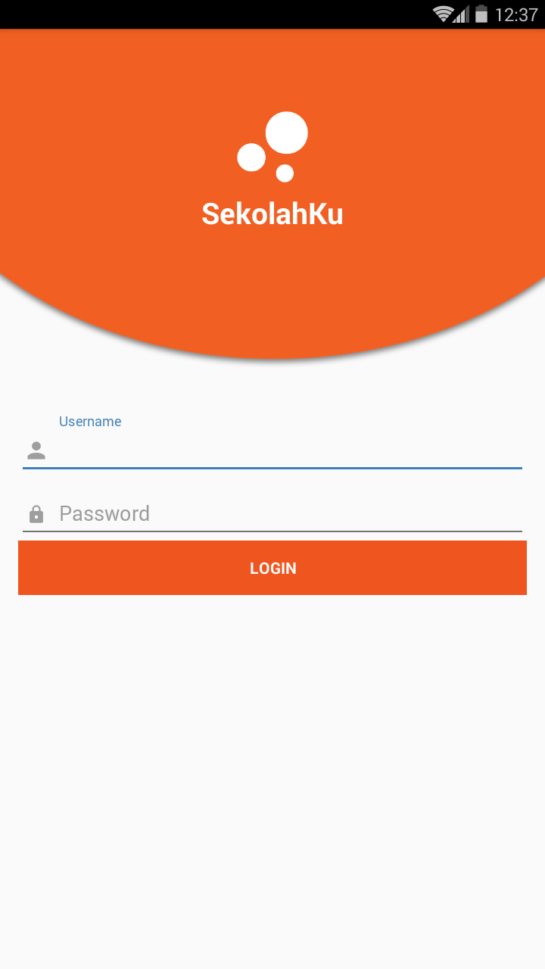
Task #12 Add new activity: LoginActivity add basic authentication, username and password are admin

Slide 18
Task #13 When success login, goto ListActivity

Slide 19
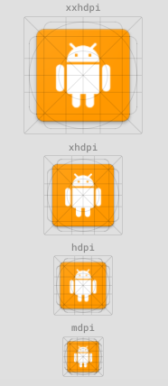
Task #14 Change icon launcher, use Android Asset Generator https://romannurik.github.io/AndroidAssetStudio/icons-launcher.html#

Slide 20
Signed APK
The Android system requires that all installed applications be digitally signed with a certificate whose private key is held by the application's developer.
The Android system uses the certificate as a means of identifying the author of an application and establishing trust relationships between applications.

Slide 21
Key Store
A public-key certificate, also known as a digital certificate or an identity certificate, contains the public key of a public/private key pair, as well as some other metadata identifying the owner of the key (for example, name and location). The owner of the certificate holds the corresponding private key.
When you sign an APK, the signing tool attaches the public-key certificate to the APK. The public-key certificate serves as a "fingerprint" that uniquely associates the APK to you and your corresponding private key. This helps Android ensure that any future updates to your APK are authentic and come from the original author. The key used to create this certificate is called the app signing key.
A keystore is a binary file that contains one or more private keys.

Slide 22
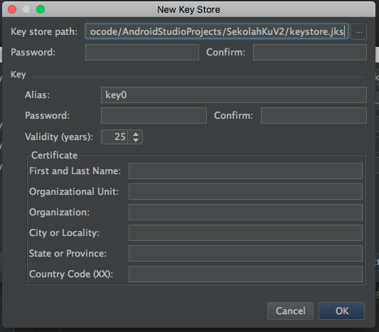
Step to Generate Signed APK
In the menu bar, click Build > Generate Signed APK.
Select a module from the drop down, and click Next.
Click Create new to create a new key and keystore.
On the New Key Store window, provide some information for your keystore.
Hit OK

Slide 23
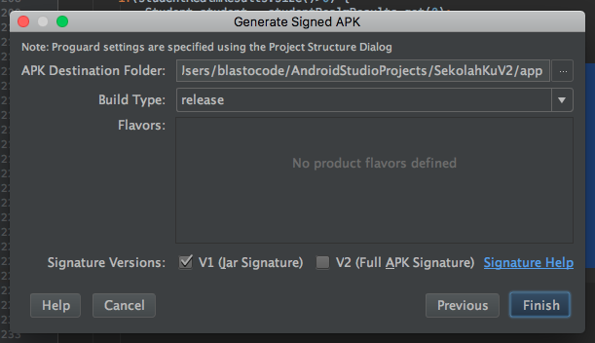
Step to Generate Signed APK
6. Clik Next
7. Choose Build Type: release
8. Tick V1 (Jar Signature) version
9. Hit Finish.

Slide 24
Final Task: Join our discussion group on Telegram t.me/BelajarCoding

Slide 25
Give us your feedback: s.id/RCFeedback

Slide 26
Final Project: s.id/ABFinalProject

